Slide 1
Poster Checklist
Branch and Agency
11.03.25

Slide 2



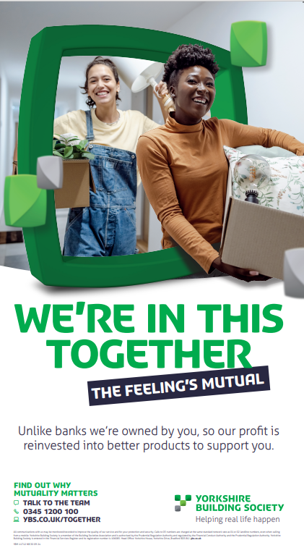
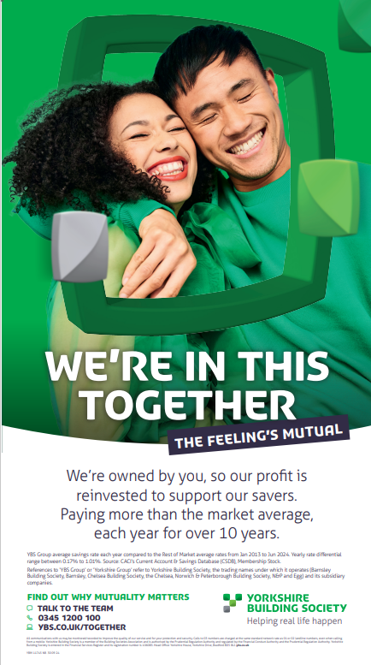



Items to display
Item | Format | Code | Display from | Priority and Instructions
Mutuality Matters | External poster | YBM11712 | Ongoing | Display and store when not in use
Mutuality Matters | Internal poster | YBM11745 | Ongoing | Display and store when not in use
A way nicer Cash ISA | External poster | YBM13510 | 11/03/2025 | Display where allocated throughout ISA season 2025
A way nicer Cash ISA | Internal poster | YBM13509 | 11/03/2025 | Display where allocated throughout ISA season 2025
Always On E-Enablement | Poster | YBM11566 | Ongoing | Display and store when not in use
Always On Savings (Loyalty) | Poster | YBM11565 | Ongoing | Display and store when not in use
MILPA Poster | Poster / Pavement Poster / Ext | YBM11506 | Ends 07/03 | Remove 07 March. Store when not in use, do not destroy.
5K Posters | External / Pavement Poster | YBM11486 21.1.2025 | 05/02/2025 | Do not Display until 05/02/2025. Store when not in use.
Loyalty Posters | Internal | YBM13166 | Ongoing | Display and store when not in use.
YBM 11468
YBM 13166
YBM11712
YBM11745
YBM11565
YBM13509
YBM13510

Slide 3

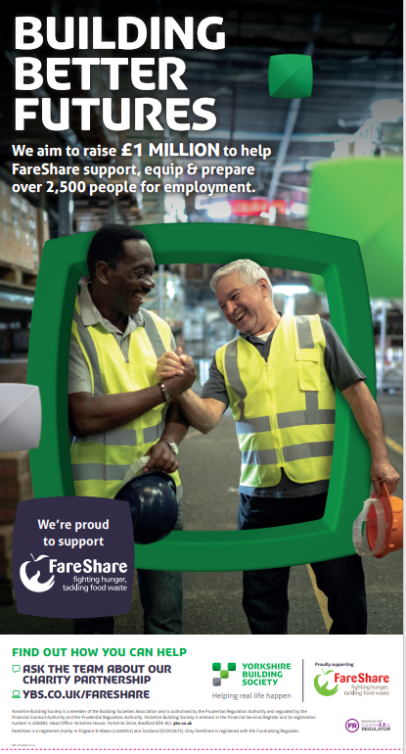
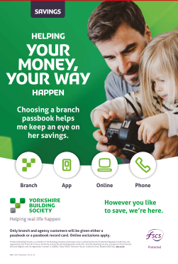
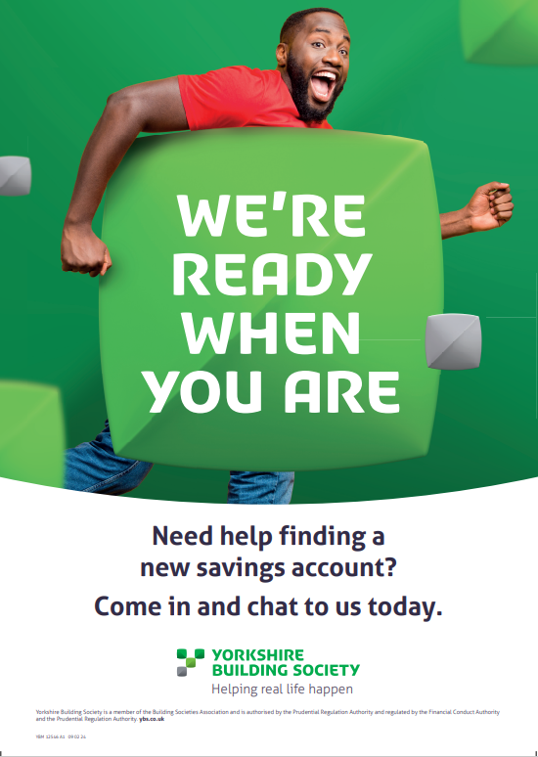
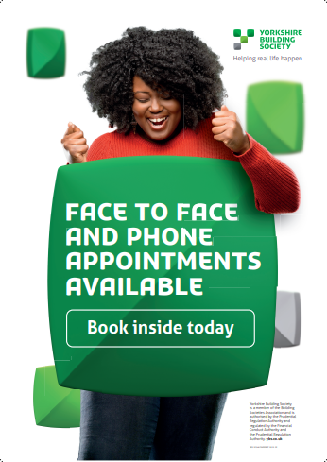
Items to display
Item | Format | Code | Display from | Instructions
YBS Member Masterclass – Cash ISAs | A4 Strut Card | YBM13511 | NEW - display | NEW – display and store when not in use
Ways of Saving – Passbook promotion | Pavement Poster | YBM11357 | Continue to display | Branch and agencies with a pavement holder. Display as you wish and please store when not in use.
Walk-in availability | Pavement Poster | YBM11416 | Continue to display | Branch and agencies with a pavement holder. Display and please store when not in use.
Savings Appointments | Pavement Poster | YBM12546 | Continue to display | Branch and agencies with a pavement holder. Display and please store when not in use.
FareShare Always On | Poster | YBM11776 | Continue to display | Display and store when not in use
YBM 13511
YBM 11776
YBM 11357
YBM 12546
YBM 11776

Slide 4



Items to remove and store
Item | Format | Code | Display from | Instructions
UKSW (UK Savings Week) 2024 | External Poster | YBM11571 | Display for UKSW from 09/09/24 to 15/09/24 | Remove and store for UKSW next year in 2025 – we will re-use these posters.
UKSW (UK Savings Week) 2024 | Internal Poster | YBM11570 | Display for UKSW from 09/09/24 to 15/09/24 | Remove and store for UKSW next year in 2025 – we will re-use these posters.
UKSW (UK Savings Week) | Bunting and Pull Up Banner |  | Display for UKSW from 09/09/24 to 15/09/24 | Remove and store for UKSW next year in 2025 – we will re-use these posters.
MILPA Poster | Poster / Pavement Poster / Ext | YBM11506 | Ends 07/03/2025 | Remove 07 March. Store when not in use, do not destroy.
YBM11571
YBM11570
YBM 11506

Slide 5

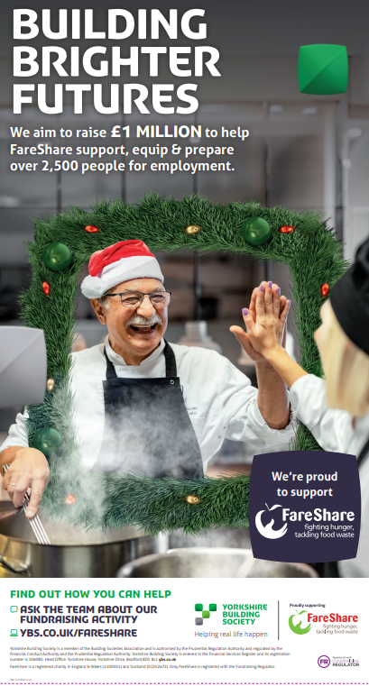

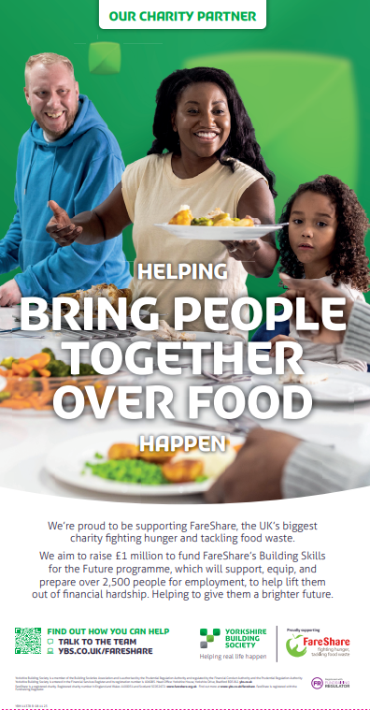

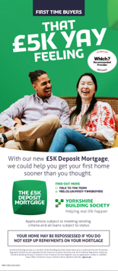



Items to destroy
Item | Format | Code | Date | Instructions
Always On – Passback | Poster | YBM11492 |  | Destroy
Always On - Fareshare Always On - FareShare | Poster Poster | YBM11378 YBM11402 |  | Destroy
5k Deposit Mortgage | External Poster | YBM11468 |  | Branch only. Destroy
UKSW (UK Savings Week) 2024 | Pavement Poster | YBM11572 |  | Destroy
FareShare Christmas | Poster | YBM11777 |  | Destroy
Always on – Mortgages Loyalty Cashback | Poster | YBM 13166 – 13.04.2023 |  | Branches only. Destroy
YBM 13166
YBM11777
YBM 11492
YBM11378
YBM11402
YBM11468
YBM11572
To check which leaflets you should be displaying, visit:
Literature Inventory & Important Information Board - Intranet (ybs.co.uk)

Slide 6
Need some help?
I don’t have enough space to display all current campaign posters:
Locations with limited poster sites should display the posters marked as priority.
My items haven’t arrived:
Most items are sent via DPD/TNT which is a courier our external printers Paragon use so please allow two working days from expected delivery before emailing retailcampaigns@ybs.co.uk
I’m missing a poster or need a replacement:
Some marketing materials will be available to order on the PEP system, so please check there in the first instance.
If the item you’re looking for isn’t on PEP, please email retailcampaigns@ybs.co.uk with the artwork code (which you’ll find at the bottom of the poster e.g YBM12345 01 01 20) and the size of the poster you require (see this guide).

