Slide 1
Poster Checklist
Branch and Agency
25.04.24

Slide 2


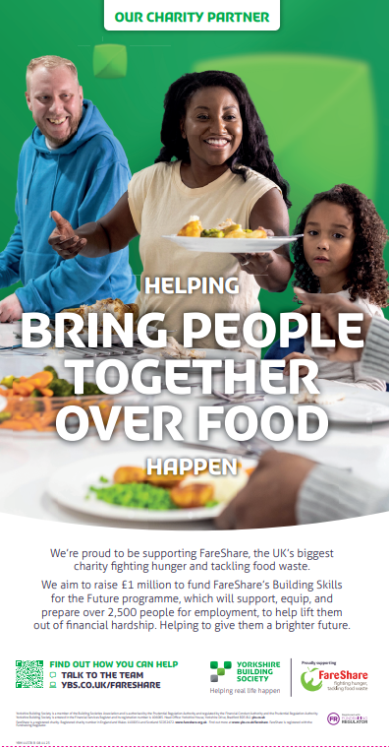

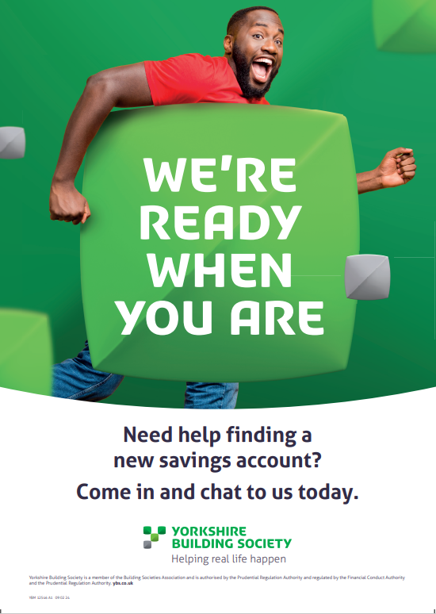
Items to display
Item | Format | Code | Display from | Instructions
Cash ISAs | External Poster | YBM 11433 | Continue to display | Display until further notice.
Walk-in availability | Pavement Poster | YBM11416 | Continue to display | Branch and agencies with a pavement holder. Display and please store when not in use.
Always On - FareShare Always On - FareShare | Poster Poster | YBM11378 YBM11402 | Continue to display | Continue to display and store when not in use (do not destroy)
YBM 11433
YBM11378 & YBM11402
YBM 11416 (pavement)

Slide 3


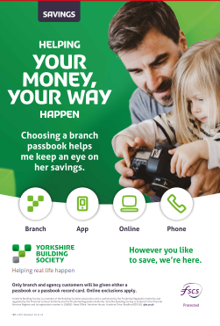
Items to display
Item | Format | Code | Display from | Instructions
Always on – Mortgages Loyalty Cashback | Poster Passbook flyer | YBM 13166 YBM 13167 | Continue to display | Store when not in use (do not destroy) Branches only
Ways of Saving – Passbook promotion | Pavement Poster | YBM11357 | Continue to display | Branch and agencies with a pavement holder. Display as you wish and please store when not in use.
YBM 13166 & 13167
YBM 11357 (pavement)

Slide 4



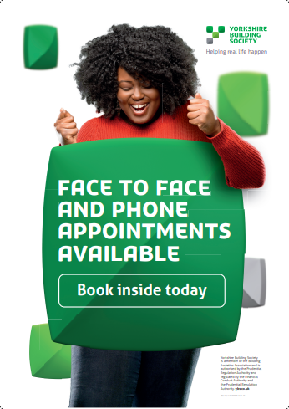

Always On - other items to display
Item | Format | Code | Date | Instructions
Always On – savings | Poster | YBM13090 | 28/11/22 | Display as you wish Store when not in use (do not destroy)
Always on – loyalty | Poster | YBM13088 | 28/11/22 | Display as you wish Store when not in use (do not destroy)
Always On - app | Poster | YBM 13089 | 28/11/22 | Display as you wish Store when not in use (do not destroy)
Always on – savings loyalty | Poster | YBM 13207 | 19/05/23 | Display as you wish Store when not in use (do not destroy)
Savings Appointment (pavement posters locations) | Pavement poster | YBM12546 | 24/12/20 | Display as you wish Store when not in use (do not destroy)
YBM 12546
YBM 13089 YBM 13088 YBM 13090 YBM 13207
To check which leaflets you should be displaying, visit:
Literature Inventory & Important Information Board - Intranet (ybs.co.uk)

Slide 5



Items to destroy
Item | Format | Code | Display until | Instructions
Loyalty ISA (Loyalty Six Access ISA 2024) | Pavement Poster | YBM 11434 A1 | 25.4.24 | Please destroy when the product is withdrawn on 25 April 2024.
Loyalty ISA (Loyalty Six Access ISA 2024) | Internal Poster | YBM 11432 | 25.4.24 | Please destroy when the product is withdrawn on 25 April 2024.
Always On – Passback | Poster | YBM 13203 | 8.2.24 | Please destroy
YBM 11432
(Internal Poster)
YBM 11434 A1
(Pavement)
YBM 13203

Slide 6
Need some help?
My items haven’t arrived:
Most items are sent via DPD/TNT which is a courier our external printers Paragon use so please allow two working days from expected delivery before emailing retailcampaigns@ybs.co.uk
I’m missing a poster or need a replacement:
Some marketing materials will be available to order on the PEP system, so please check there in the first instance.
If the item you’re looking for isn’t on PEP, please email retailcampaigns@ybs.co.uk with the artwork code (which you’ll find at the bottom of the poster e.g YBM12345 01 01 20) and the size of the poster you require (see this guide).

